Slide 1
QuizZoodle: capture your audience!
J. Allali - QuizZoodle

Slide 2
Survey example
#QDLE#S#ABCD#
How are you today?
A. Excellent
B. Very Good
C. Good
D. Not so Good

Slide 3
Let’s do some maths
Fibonacci number are the numbers of the following sequence:
0,1,1,2,3,5,8,13,21,...
That is F₀ =0 ; F₁ =1 and F_{n} = F_{n-1} + F_{n-2}

Slide 4
Let’s do some maths
#QDLE#Q#AB*C#
Fibonacci number are the numbers of the following sequence:
0,1,1,2,3,5,8,13,21,...
That is F₀ =0 ; F₁ =1 and F_{n} = F_{n-1} + F_{n-2}
If F_{i}=6765 and F_{i+2}=17711, what is F_{i+1}?
A. 10935
B. 10946
C. 10966

Slide 5
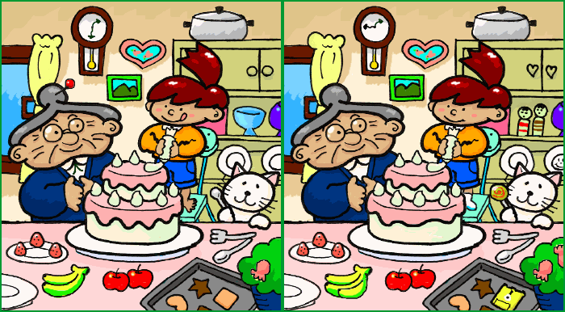
Just for fun
#QDLE#Q#ABC*#120#
How many errors?
A. 7
B. 10
C. 15
source: wikipedia, author: Muband

Slide 6
QdleTag How to…
Including QuizZoodle into your presentation is really easy.
Just design your slides and include a tag into slides that contain quizz or survey

Slide 7
QdleTag How to…
The regular expression for tags is the following:
#QDLE#(Q|S)#[ABCD*]+#([0-9]+#)?
start with #QDLE#
if its a question Q# followed by the set of possible answers (ABCD), the right one must be followed by a *
if its a survey S# followed by the set of possible answers
optionally a specific timeout (if not set, the global quizz timeout will be used).

Slide 8
QdleTag how to…
Be sure to add tags in separate text box.
Hope you enjoy QuizZoodle and will use it very soon!

Slide 9
QdleTag how to…
#QDLE#S#ABCD#45#
Be sure to add tags in separate text box.
Hope you enjoy QuizZoodle and will use it very soon!
How do you find the presentation?
A. awesome
B. very cool
C. nice
D. useless

